Slide 1

RUNGTA COLLEGE OF DENTAL SCIENCES AND RESEARCH
NEPHRITIS
DEPARTMENT OF GENERAL MEDICINE

Slide 2
SPECIFIC LEARNING OBJECTIVES
MUST KNOW | NICE TO KNOW | DESIRE TO KNOW
WHAT IS NEPHRITIS? | ASSESSMENT AND DIAGNOSTIC FINDINGS | A&P REVIEW
TYPES | MEDICATIONS
ACUTE NEPHRITIC SYNDROME | NURSING MANAGEMENT

Slide 3
CONTENTS
INTRODUCTION
TYPES
A &P REVIEW
ACUTE NEPHRITIC SYNDROME
ASSESSMENT AND DIAGNOSTIC FINDINGS
MEDICATIONS
NURSING MANAGEMENT
CHRONIC GLOMERULONEPHRITIS
ASSESSMENT AND DIAGNOSTIC FEATURES
MEDICATIONS
NURSING MANAGEMENT
CONCLUSION

Slide 4
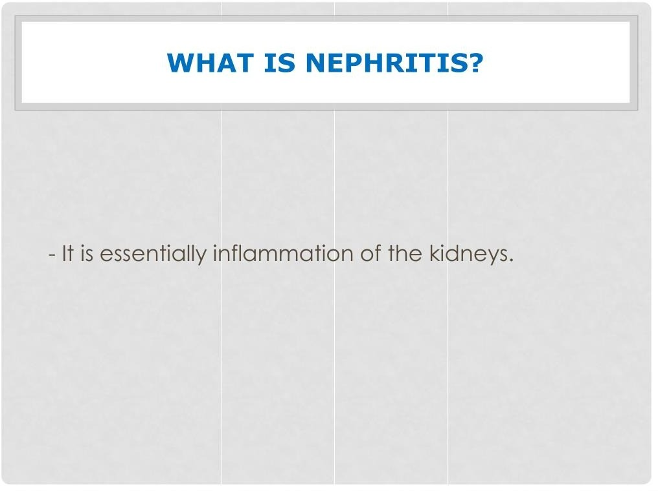

Slide 5
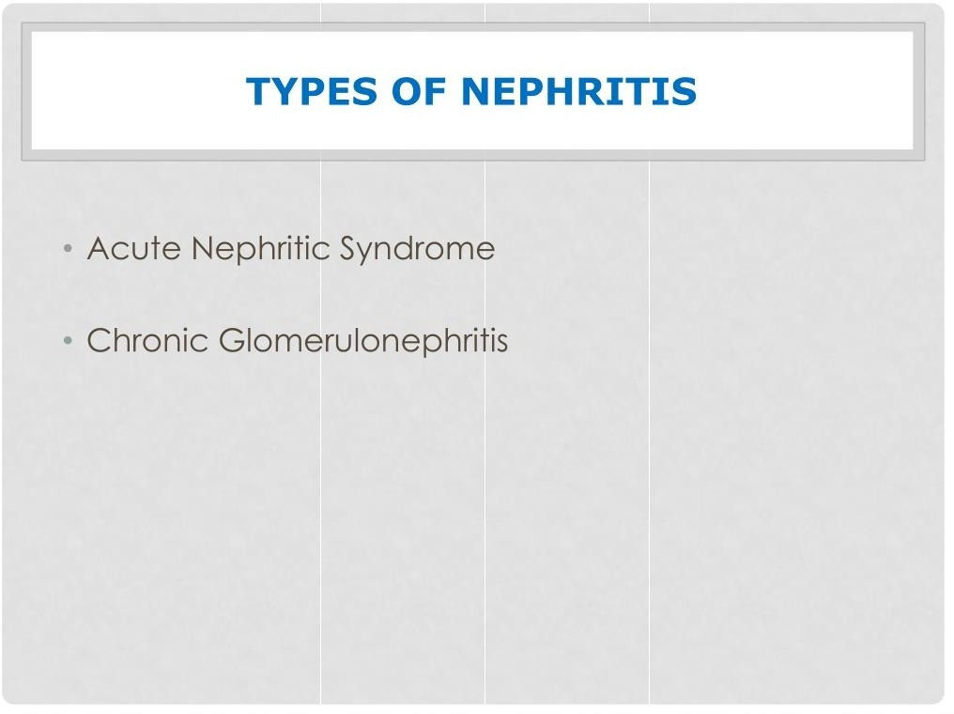

Slide 6
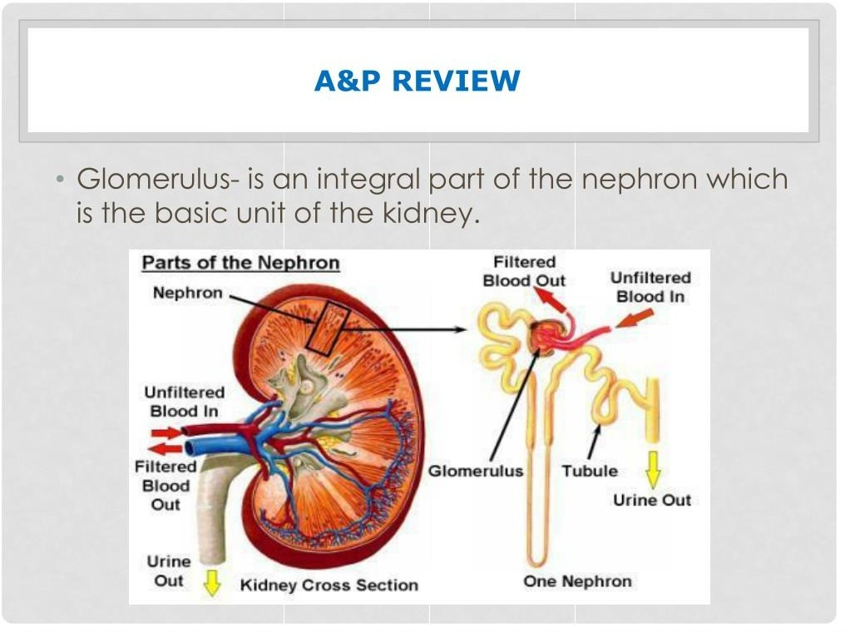

Slide 7
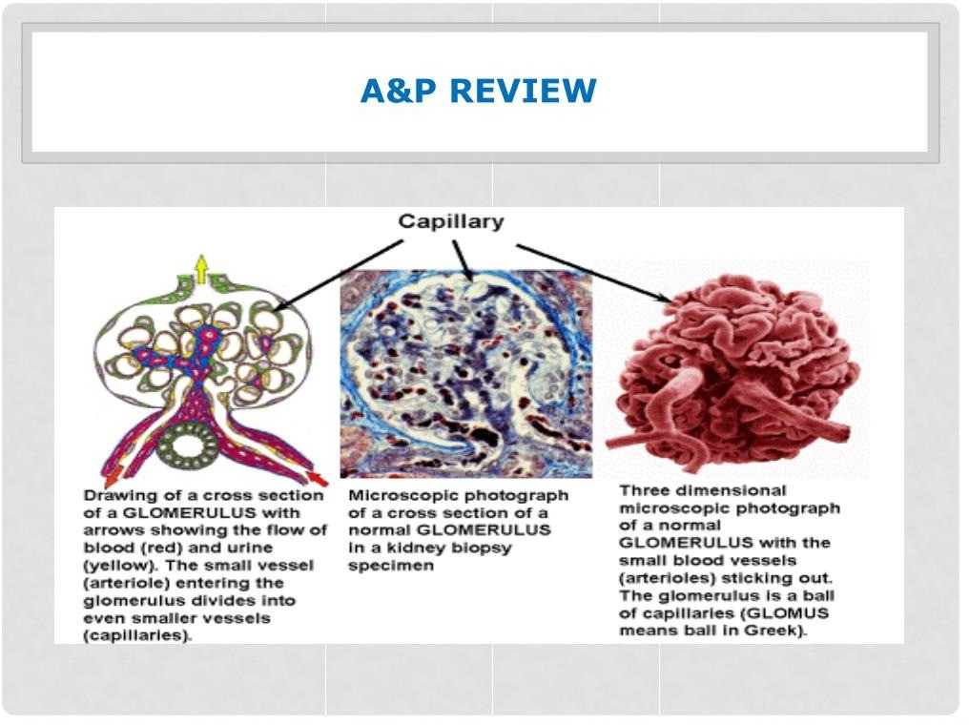

Slide 8
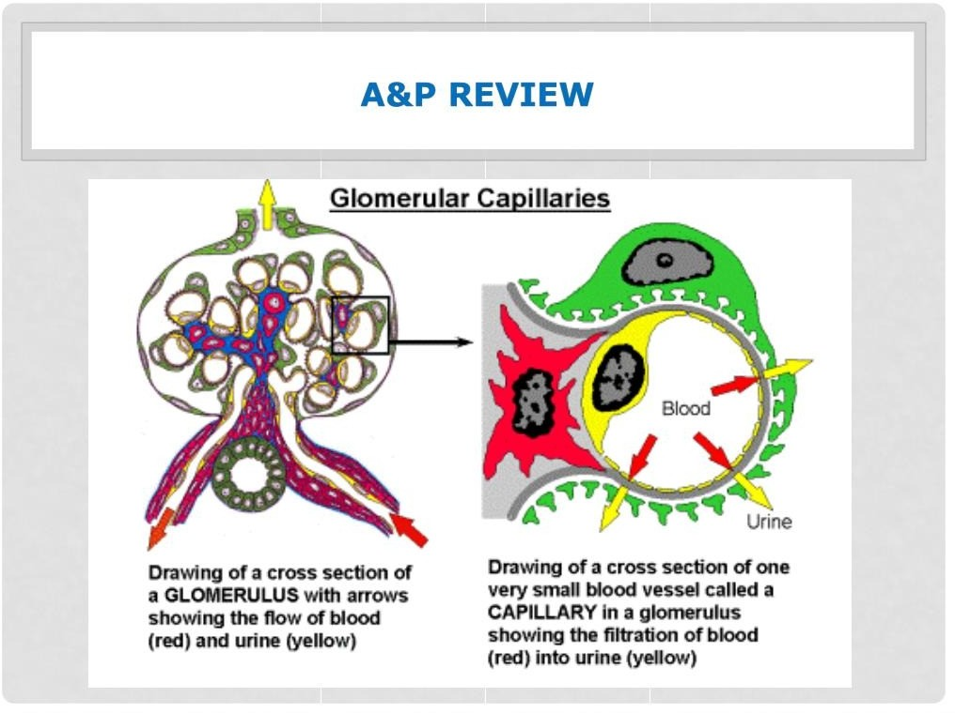

Slide 9
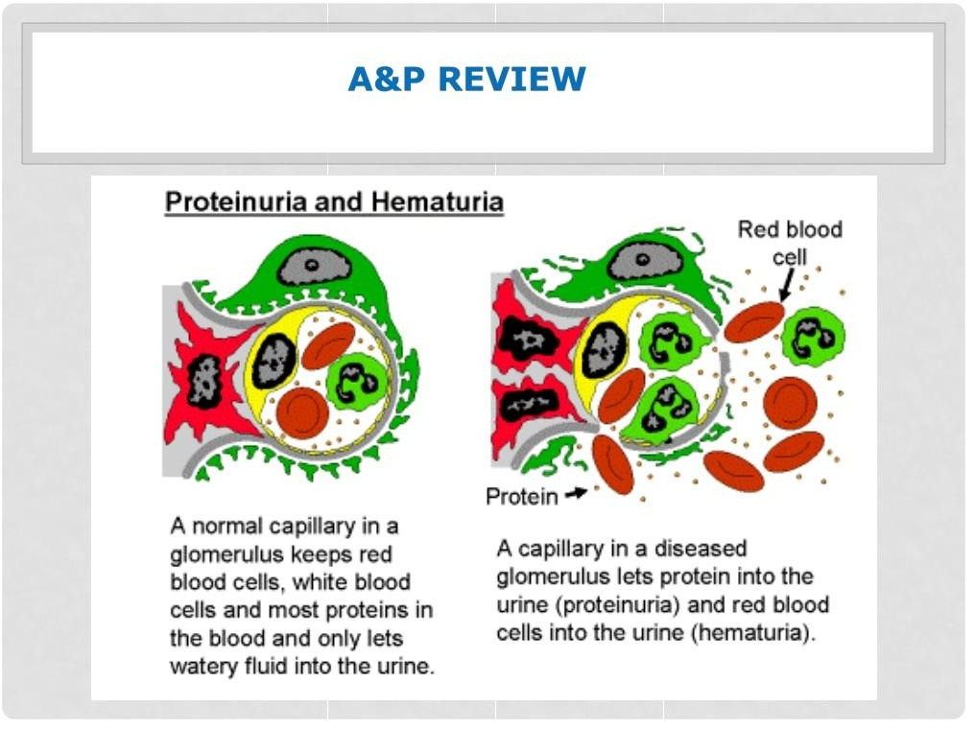

Slide 10
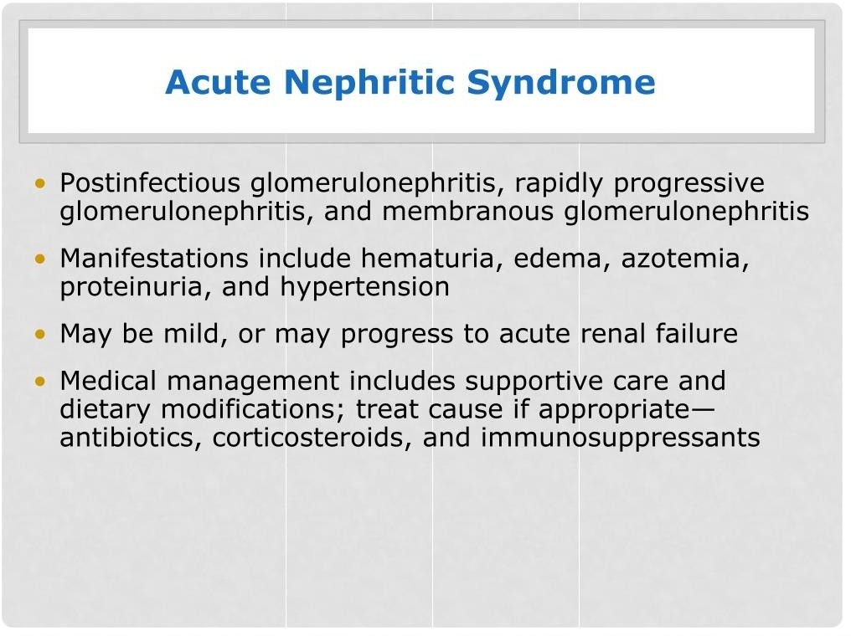

Slide 11
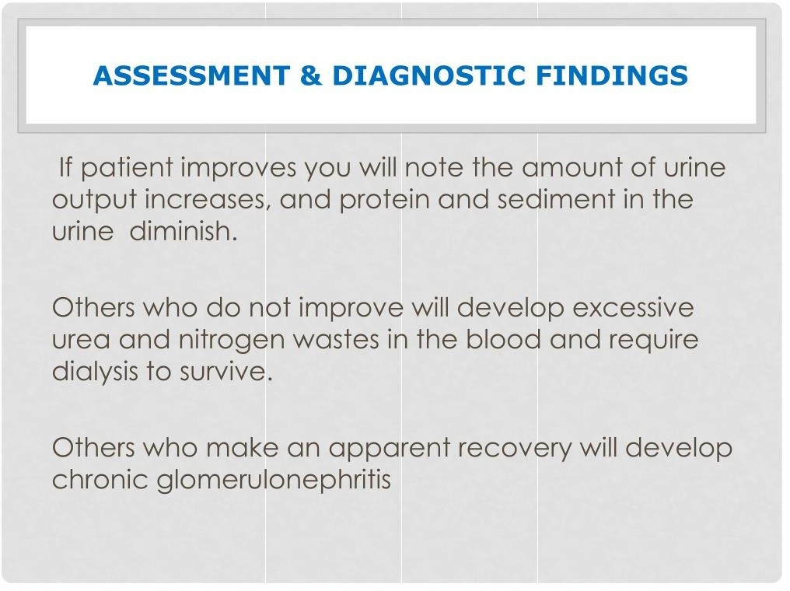

Slide 12
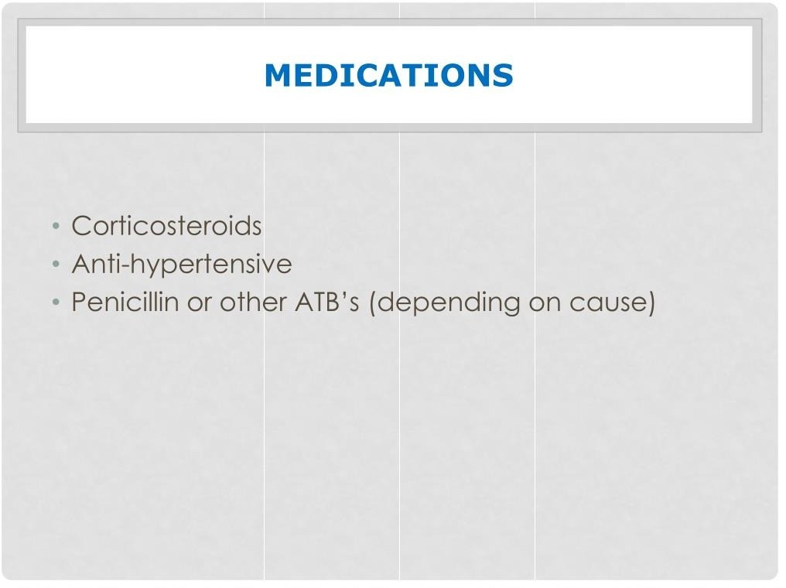

Slide 13
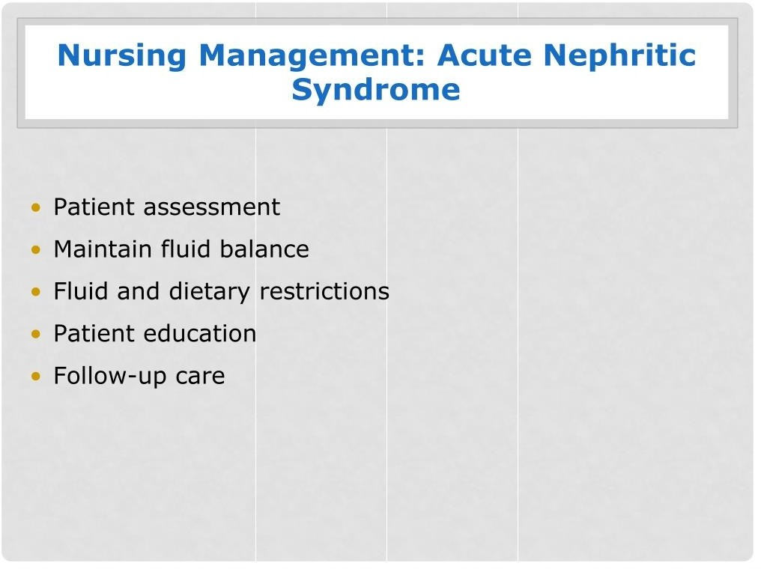

Slide 14
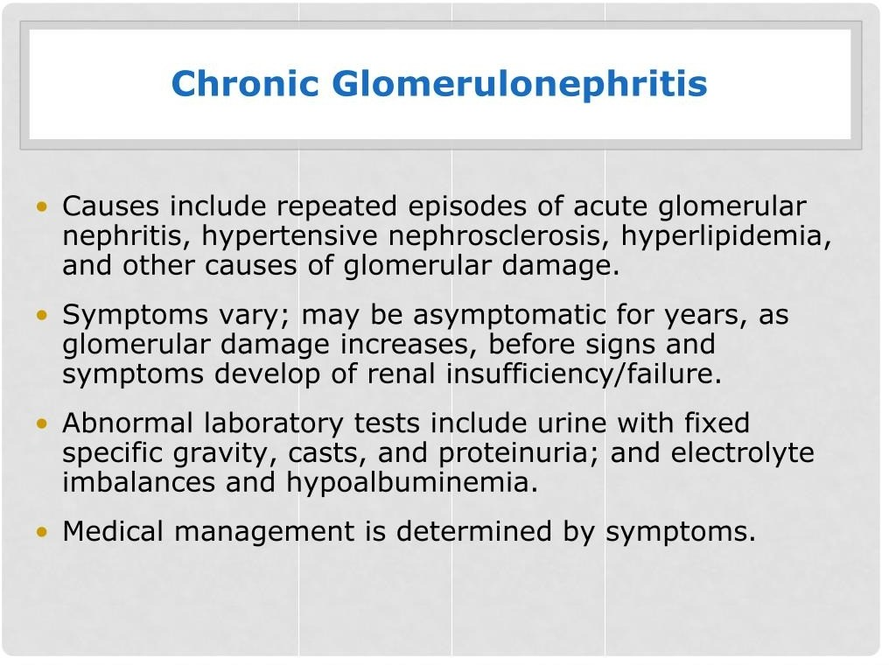

Slide 15
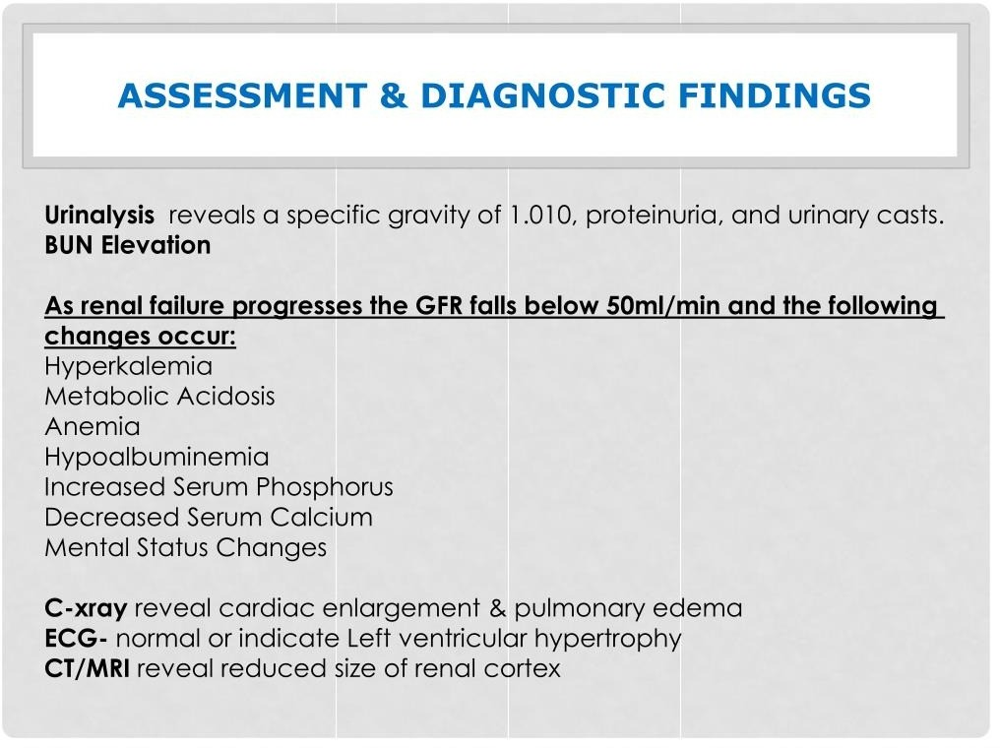

Slide 16
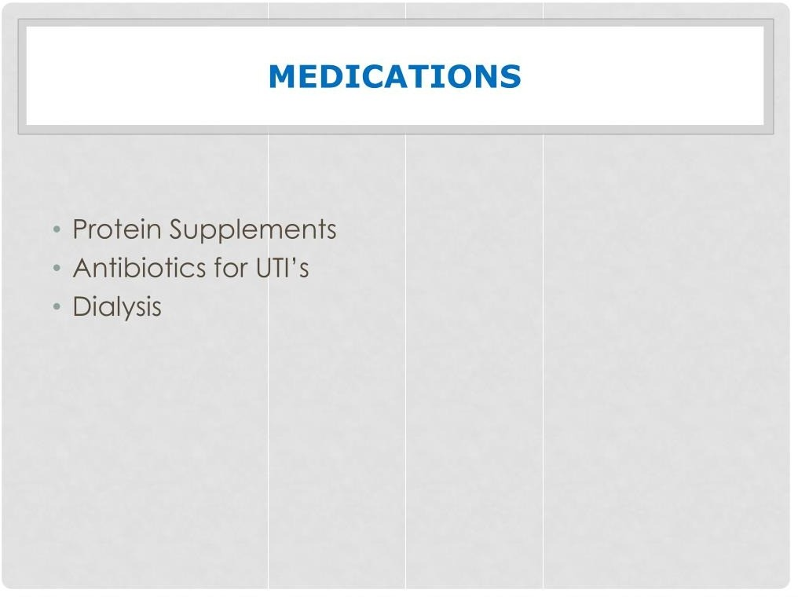

Slide 17
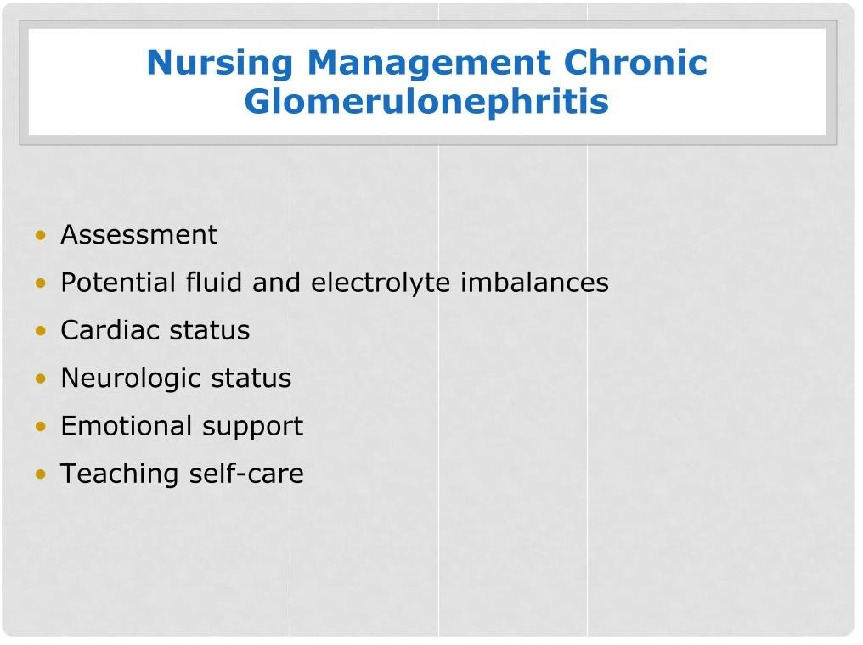

Slide 18
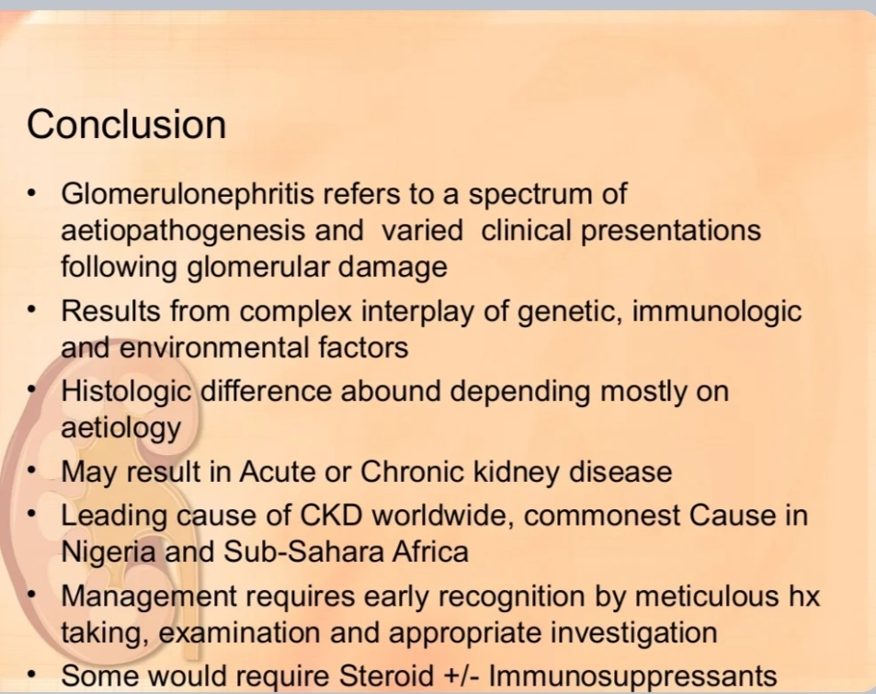

Slide 19
REFERENCES
DAVIDSON’S PRINCIPLES AND PRACTICE OF MEDICINE; 23rd edition
HARRISON’S PRINCIPLE OF INTERNAL MEDICINE; 21ST edition
TEXTBOOK OF CLINICAL MEDICINE by S.N Chugh ;5th edition

Slide 20
QUESTIONS AND ANSWERS

Slide 21
THANK YOU.....

